Slide 1
Module – A The 8085 Microprocessor DIVYA SINGH

Slide 2
Pin Configuration of 8085
It has 40 pins and uses +5V for power. It can run at a maximum frequency of 3 MHz.
The pins on the chip can be grouped into 6 groups:
Address Bus.
Data Bus.
Control and Status Signals.
Power supply and frequency.
Externally Initiated Signals.
Serial I/O ports.

Slide 3
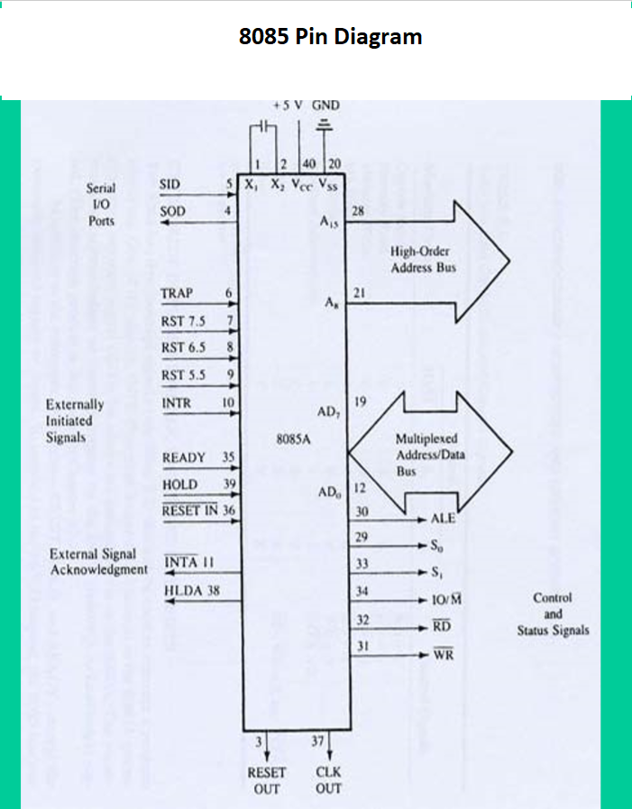

Slide 4
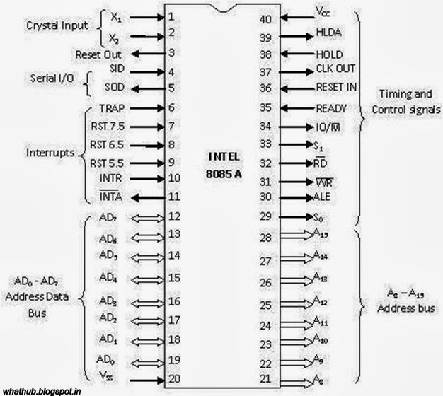
Intel 8085 Pin Configuration

Slide 5
The Address and Data Busses
The address bus has 8 signal lines A8 – A15 which are unidirectional.
The other 8 address bits are multiplexed (time shared) with the 8 data bits.
So, the bits AD0 – AD7 are bi-directional and serve as A0 – A7 and D0 – D7 at the same time.
During the execution of the instruction, these lines carry the address bits during the early part, then during the late parts of the execution, they carry the 8 data bits.
In order to separate the address from the data, we can use a latch to save the value before the function of the bits changes.

Slide 6
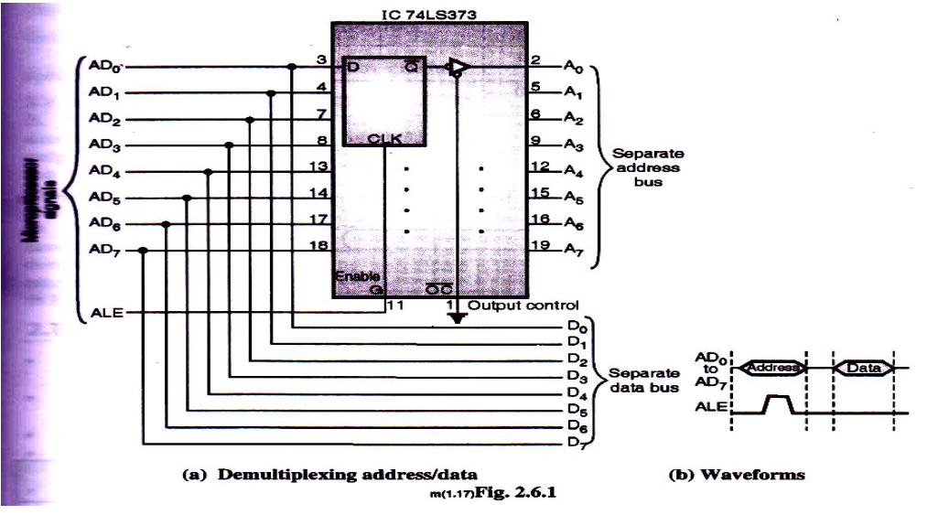

Slide 7
INCREMENT/ DECREMENT ADDRESS LATCH
Interrupt Control:
Fetch, Decode & execute
RST 5.5, RST 6.5, RST 7.5, TRAP, & INTR
INTA
Serial I/O Control
SOD & SID
Timing and Control Circuitry
IO/M, S1,S0,RD & WR

Slide 8
Frequency Control Signals
There are 3 important pins in the frequency control group.
X0 and X1 are the inputs from the crystal or clock generating circuit.
The frequency is internally divided by 2.
So, to run the microprocessor at 3 MHz, a clock running at 6 MHz should be connected to the X0 and X1 pins.
CLK (OUT): An output clock pin to drive the clock of the rest of the system.

Slide 9
The Control and Status Signals
There are 4 main control and status signals. These are:
ALE: Address Latch Enable. This signal is a pulse that become 1 when the AD0 – AD7 lines have an address on them. It becomes 0 after that. This signal can be used to enable a latch to save the address bits from the AD lines.
RD: Read. Active low indicates that the data must be read from the selected memory location or I/O port via data bus.
WR: Write. Active low indicates that the data must be written into the selected memory location or I/O port via data bus..
IO/M: This signal specifies whether the operation is a memory operation (IO/M=0) or an I/O operation (IO/M=1).
S1 and S0 : Status signals to specify the kind of operation being performed .Usually un-used in small systems.

Slide 10
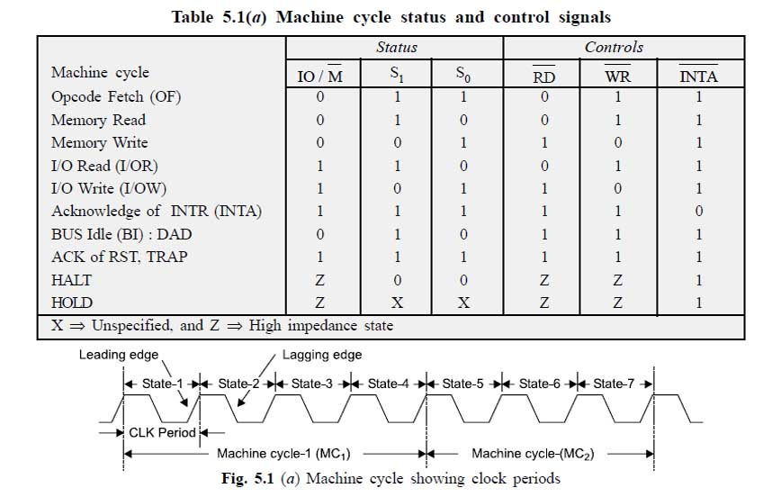
IO/M, S1 & S0

